Slide 1
Realistic Models of Human Perception Microperimetry Simulations
MDAP Semester 1, 2026 – Nicholas Cotugno Morrison
Supervised by Damien Mannion

Slide 2
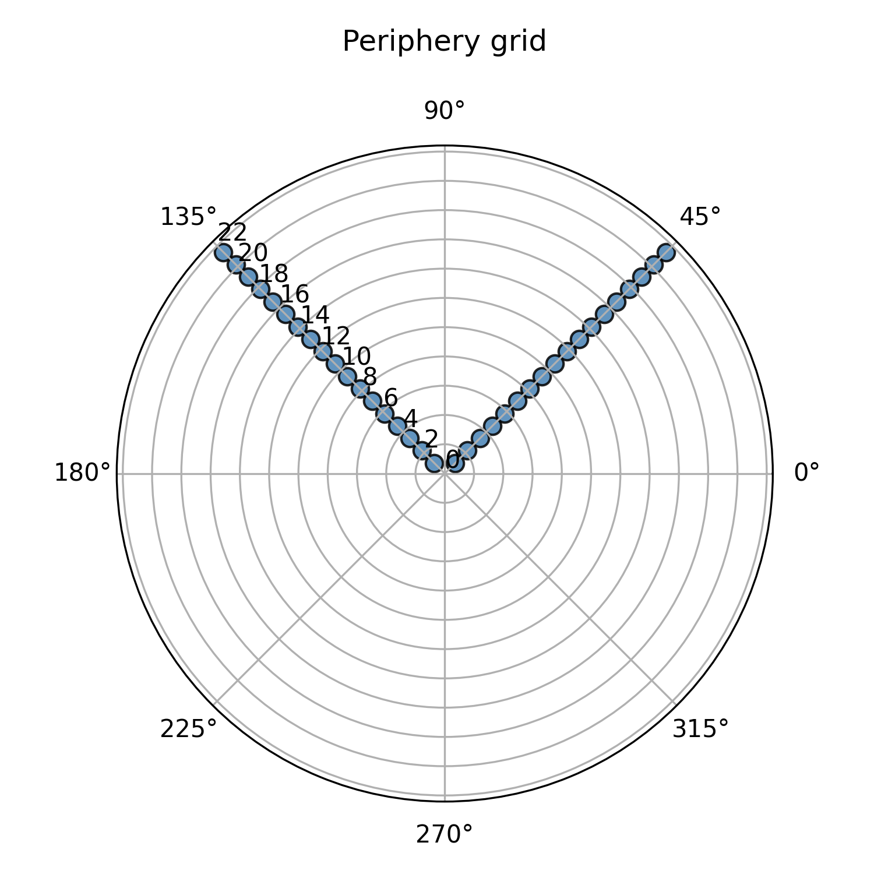
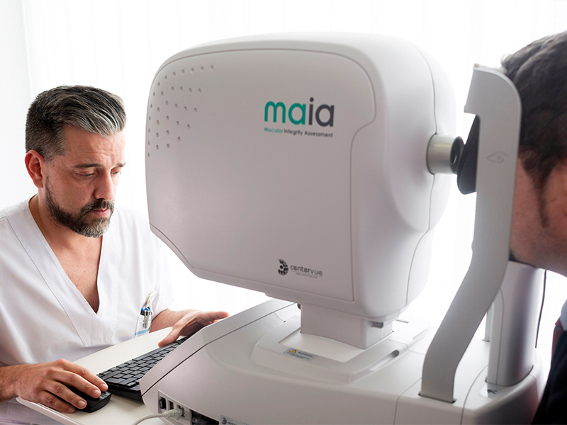
What is microperimetry?
But how do you tell the difference between real vision loss and a patient simply missing a button press?
Clínica Barraquer (2019) New technology for studying the macula: the MAIA
‌

Slide 3
Building an accurate model
You can’t trust people!
Bias (some people are ‘trigger-happy’)
Noise (Fatigue/Loss of focus etc)
Are the patient’s results due to disease or unreliable responses?

Slide 4
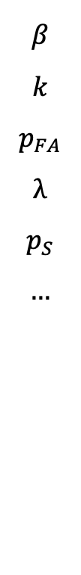
The answer?
An accurate Observer Model and Spatial Model
Signal Detection Theory + Bayesian Statistics to model human behavior and the visual field
Bias (trigger happy?)
False alarm
Fatigue/Loss of focus
Assigning uncertainty to whether a response is genuine or random.
$$β$$
$$k$$
$$p_{FA}$$
$$λ$$
$$p_{S}$$
$$…$$
Each with their own prior belief

Slide 5
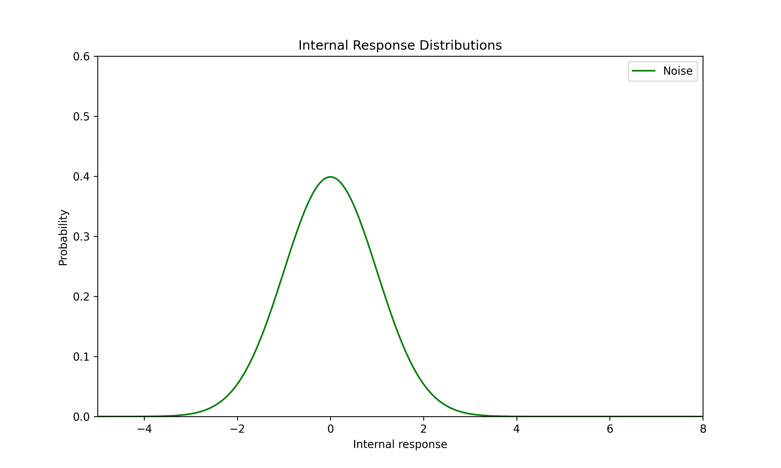
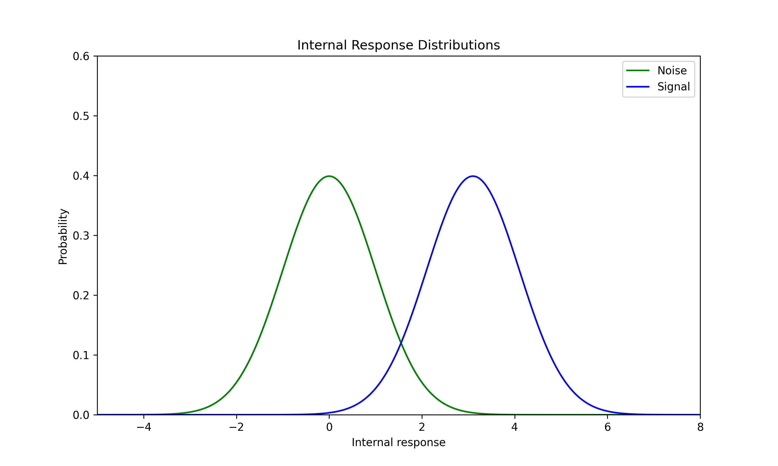
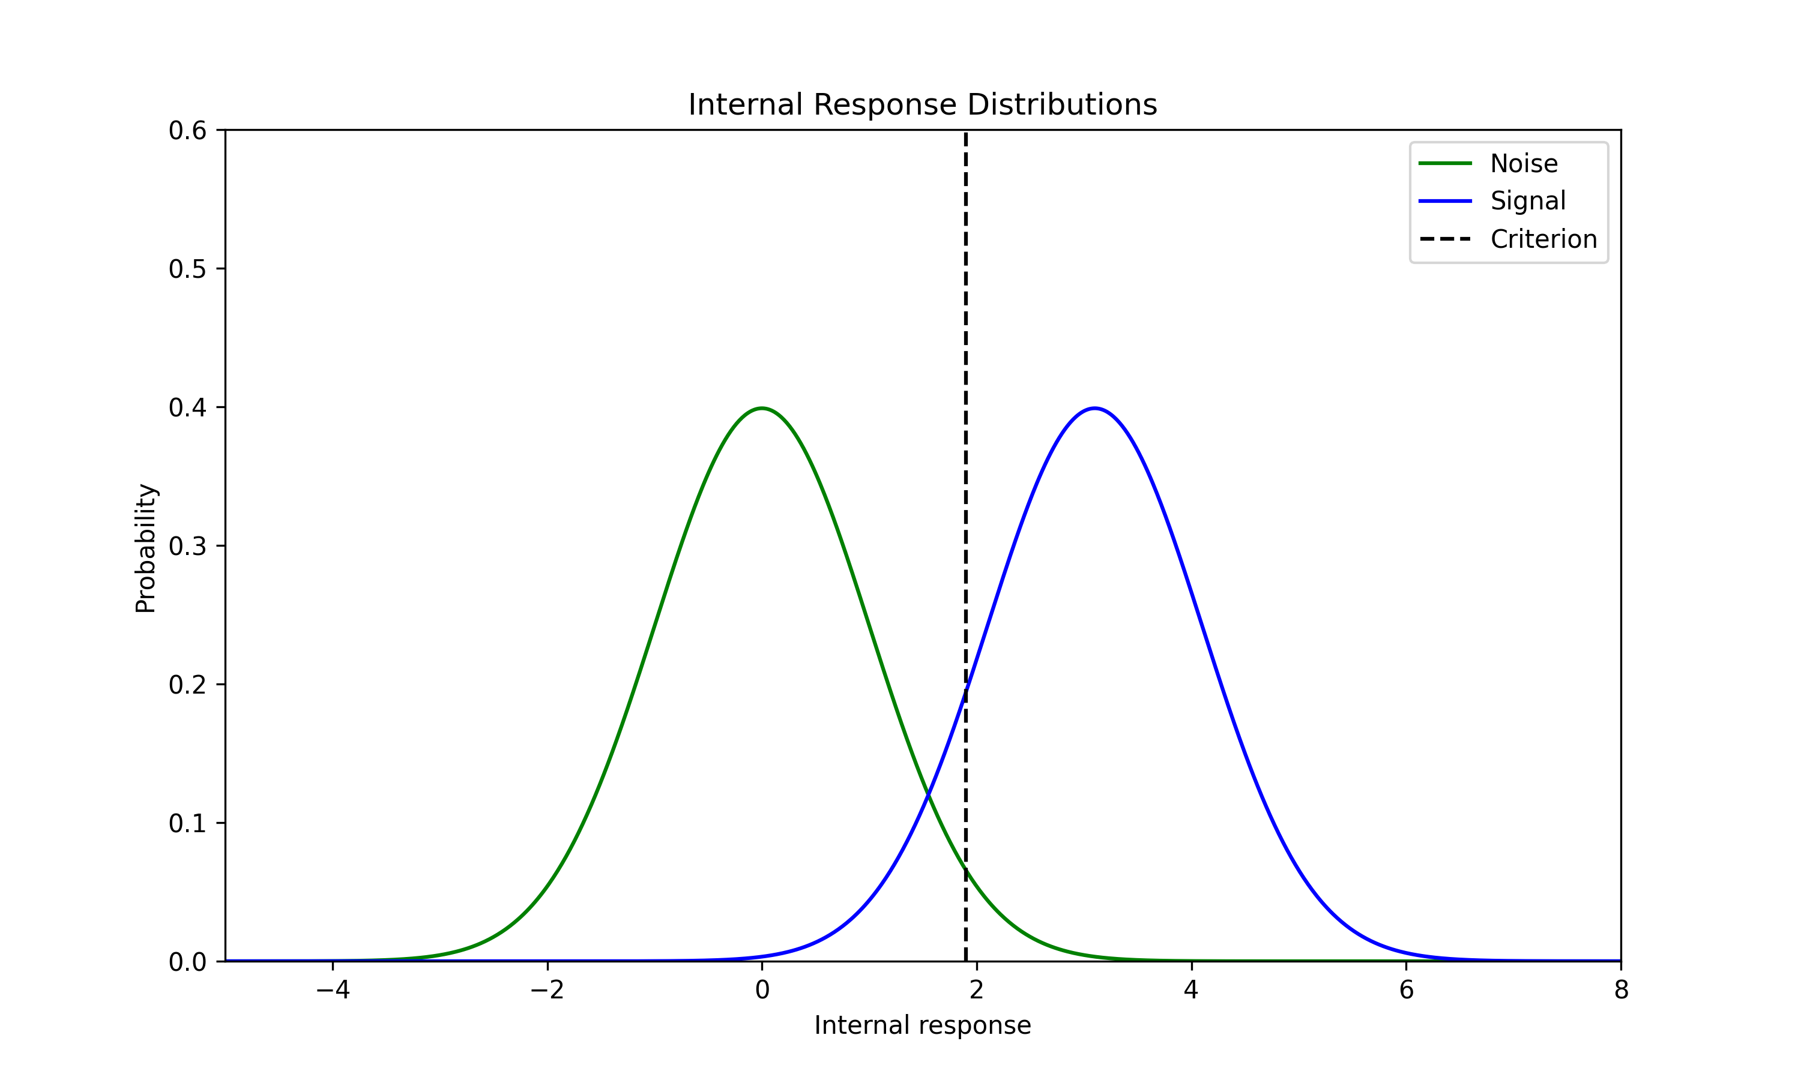
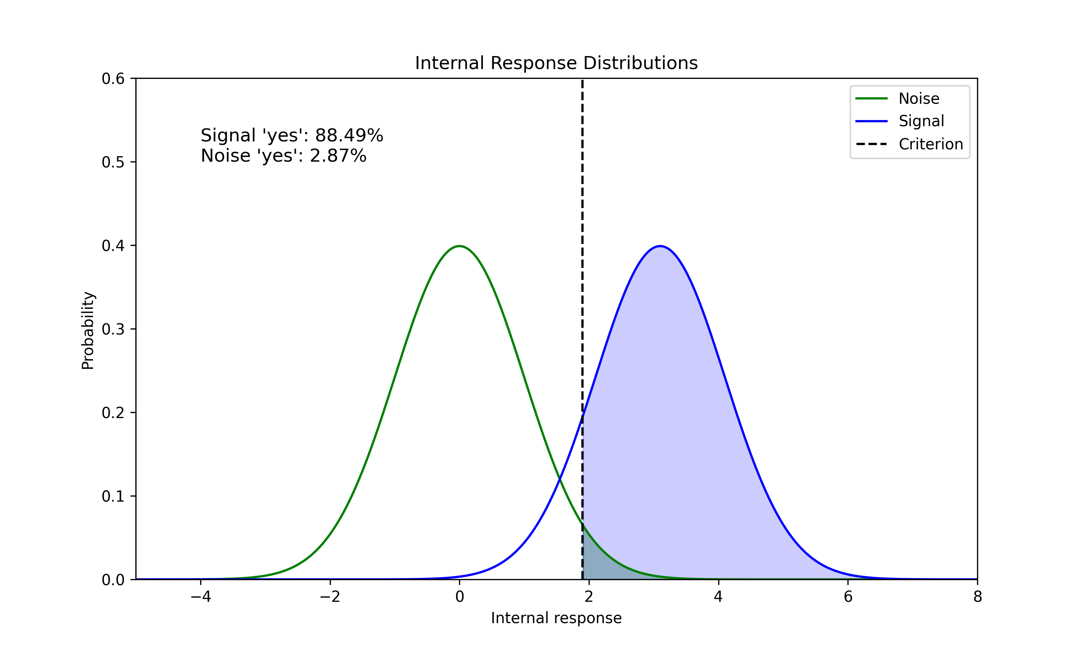
Signal Detection Theory (background)

Slide 6
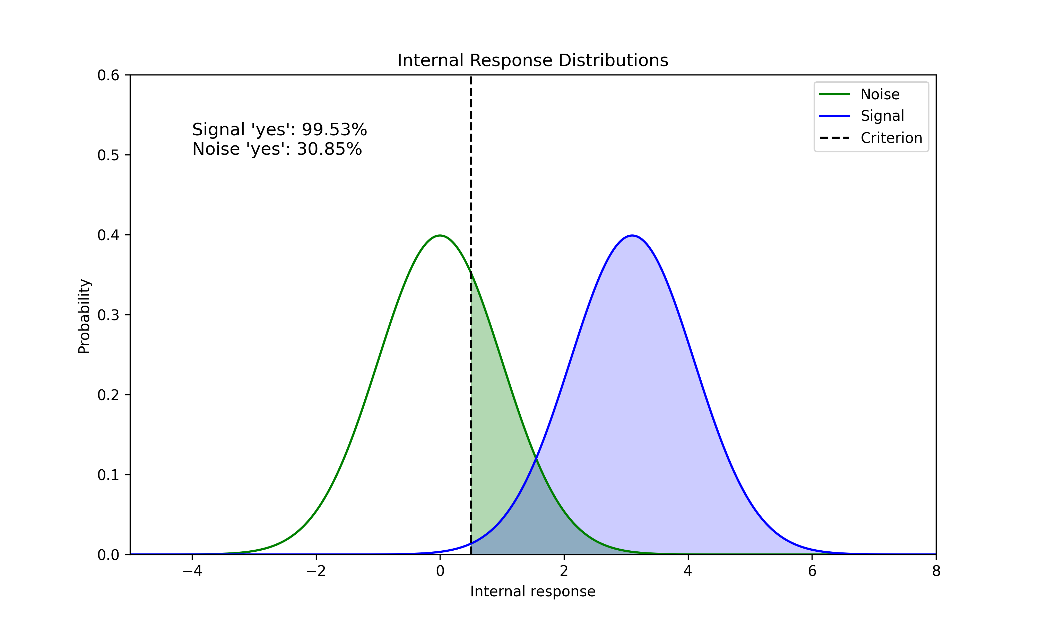
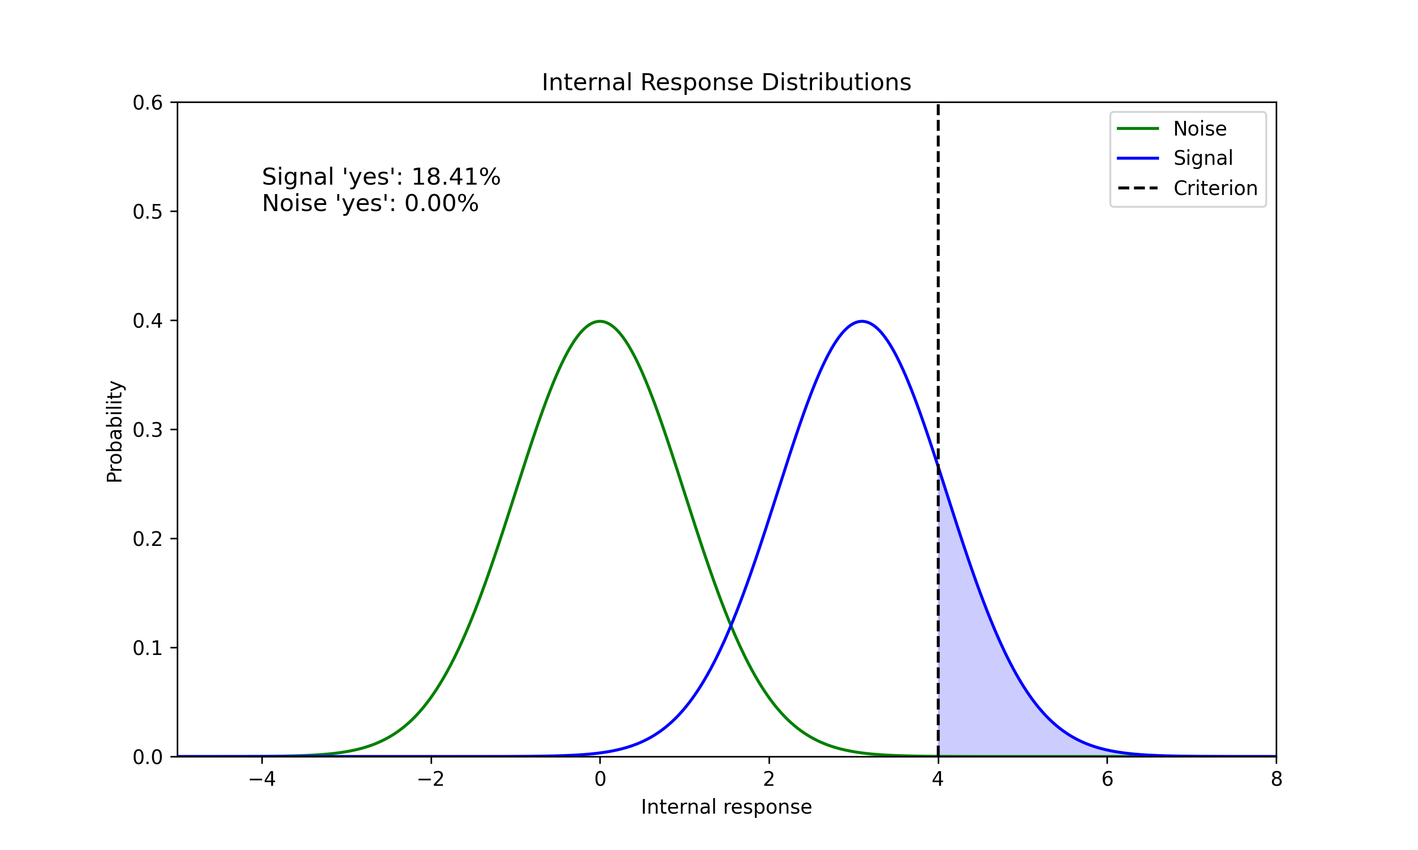
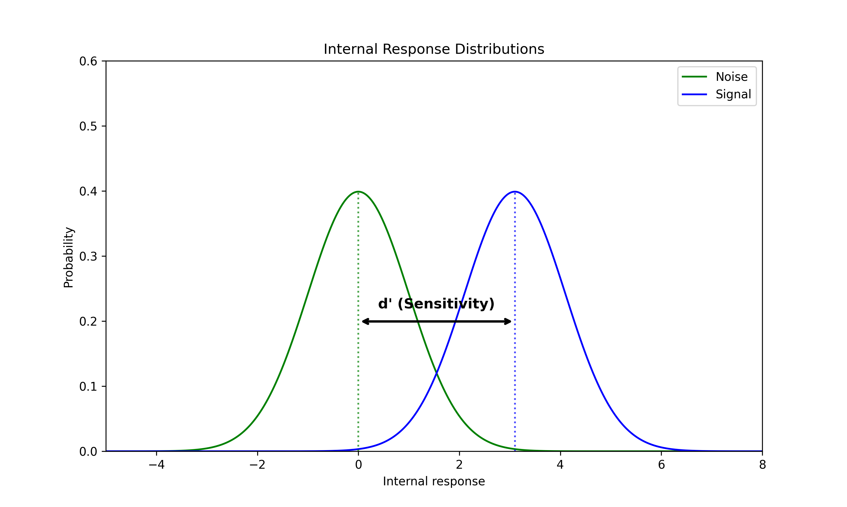
Signal Detection Theory (background)

Slide 7
What I worked on
Modelled the visual field as location dependent
Incorporated prior distributions for several parameters
Ran large-scale simulations in parallel on SPARTAN

Slide 8
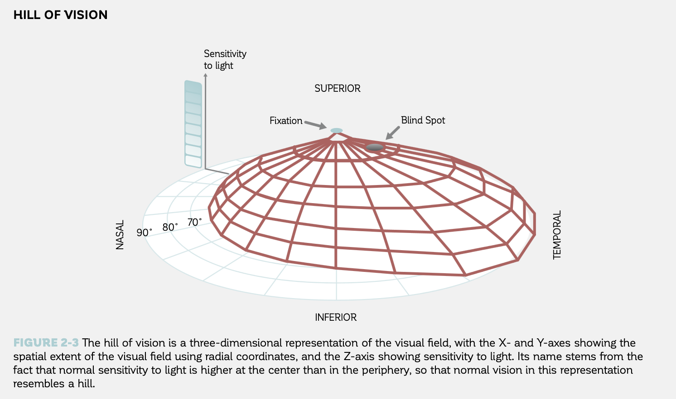
Modelling the periphery
Visual Field Digest, 8th ed. (2019). Haag-Streit AG, Köniz, Switzerland.
‌

Slide 9
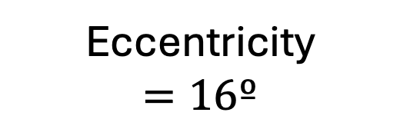
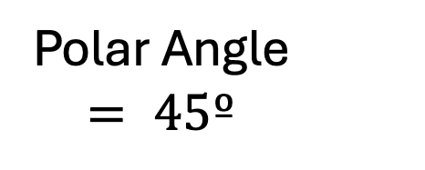
Modelling the periphery
Need a way of defining the correlation between points in the visual field that best mimics true vision
Eccentricity
$$=16º$$
Polar Angle
$= 45º$

Slide 10
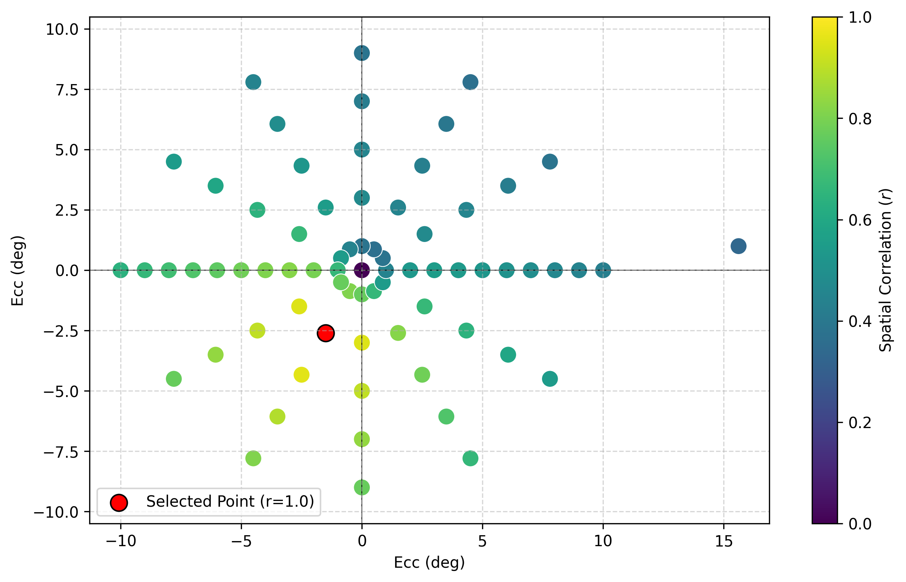
Spatial correlation

Slide 11
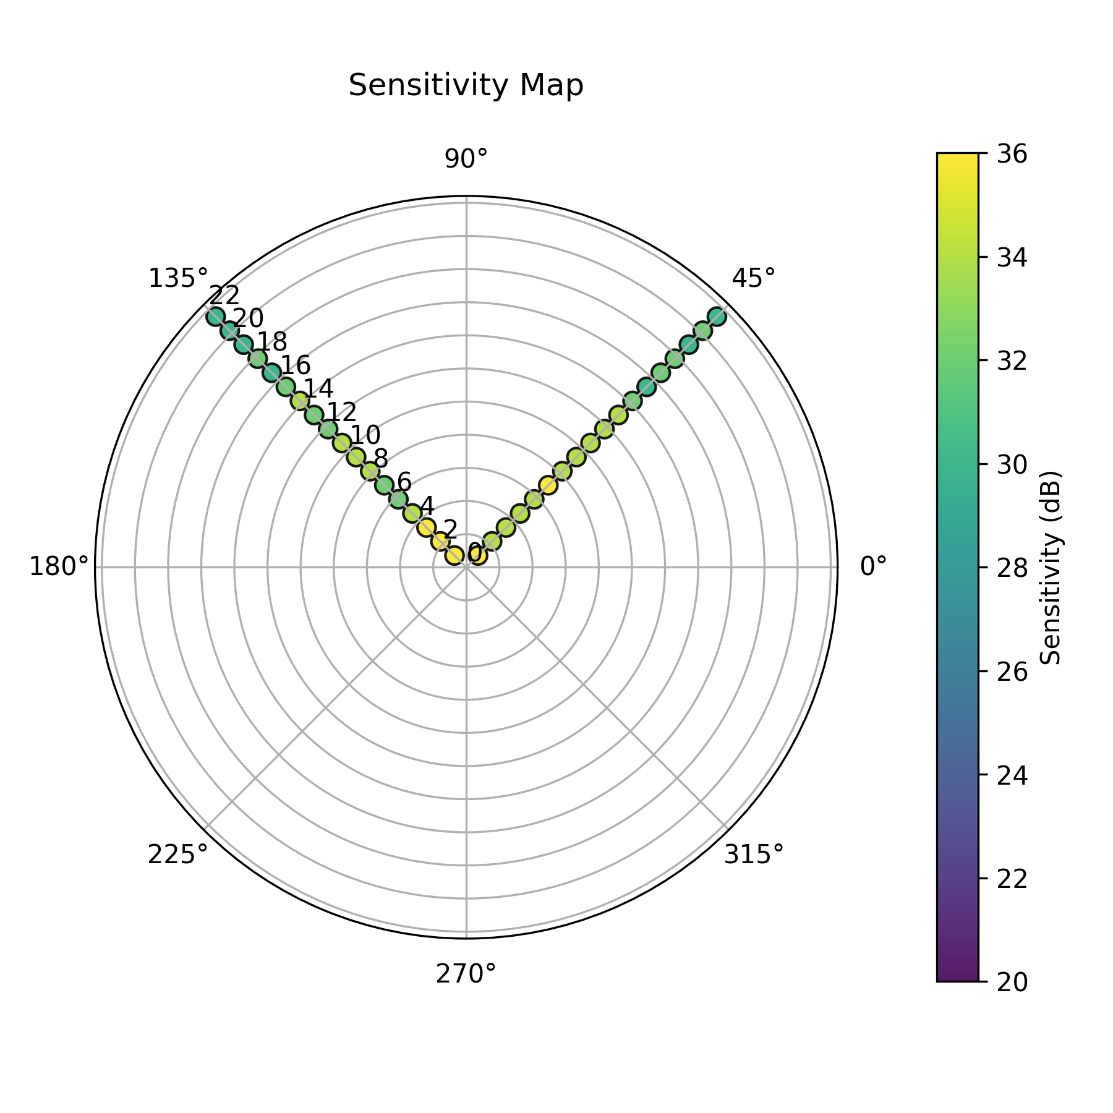
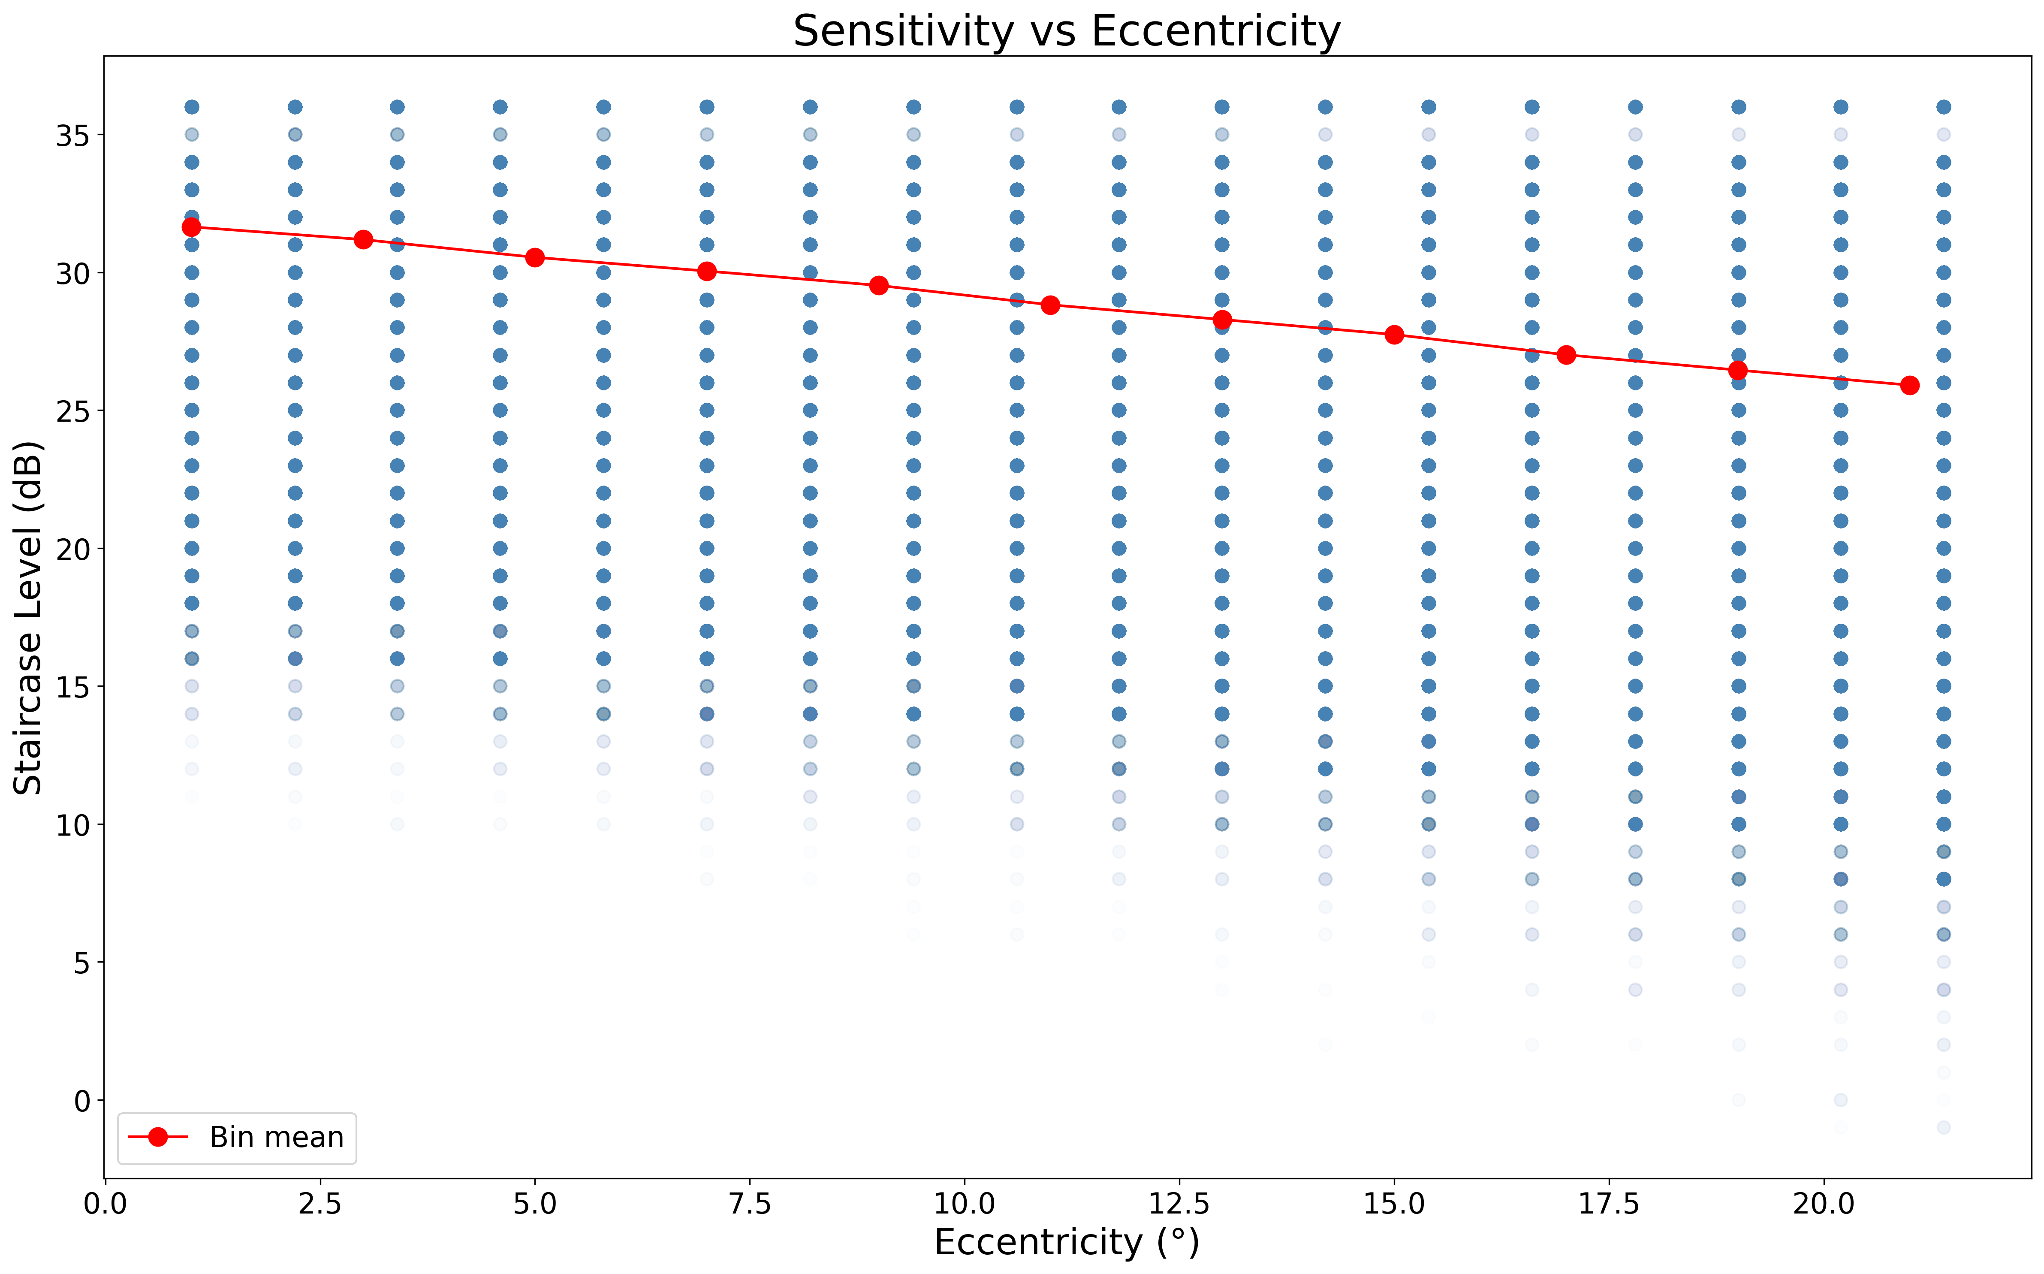
Decay with periphery

Slide 12
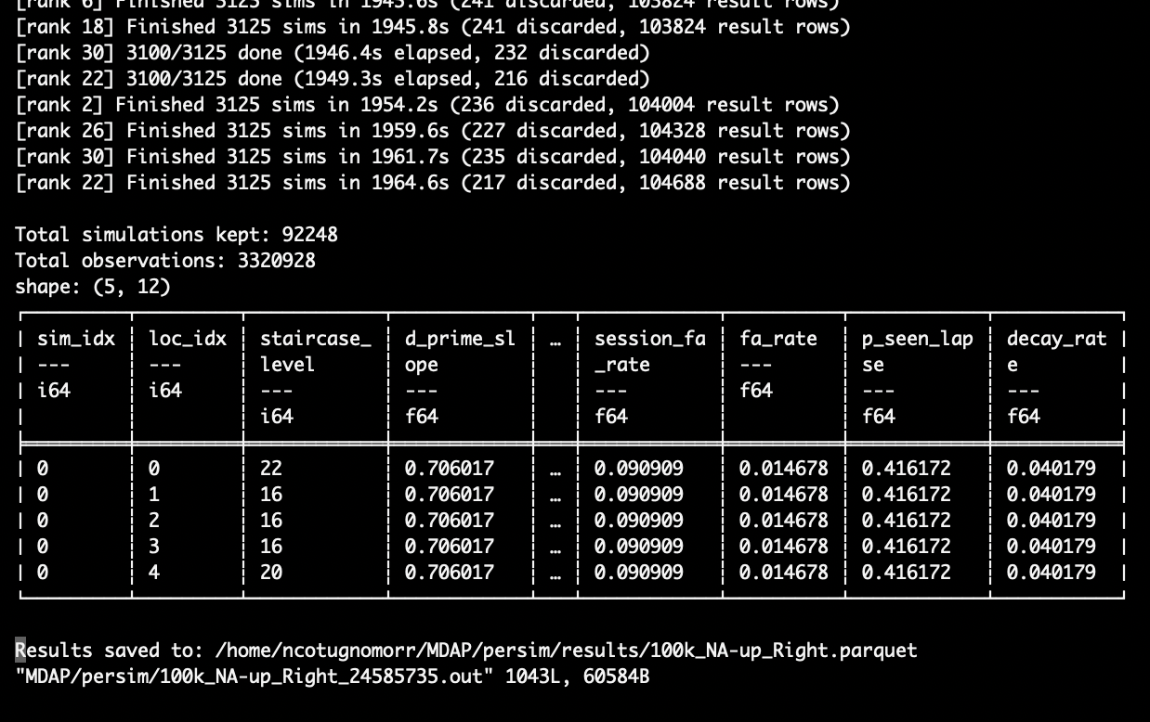

Simulations in Parallel
Parallelised the core simulation script to run across multiple processors on the SPARTAN HPC cluster
100,000 simulations (32 cores) ~ 32 mins

Slide 13
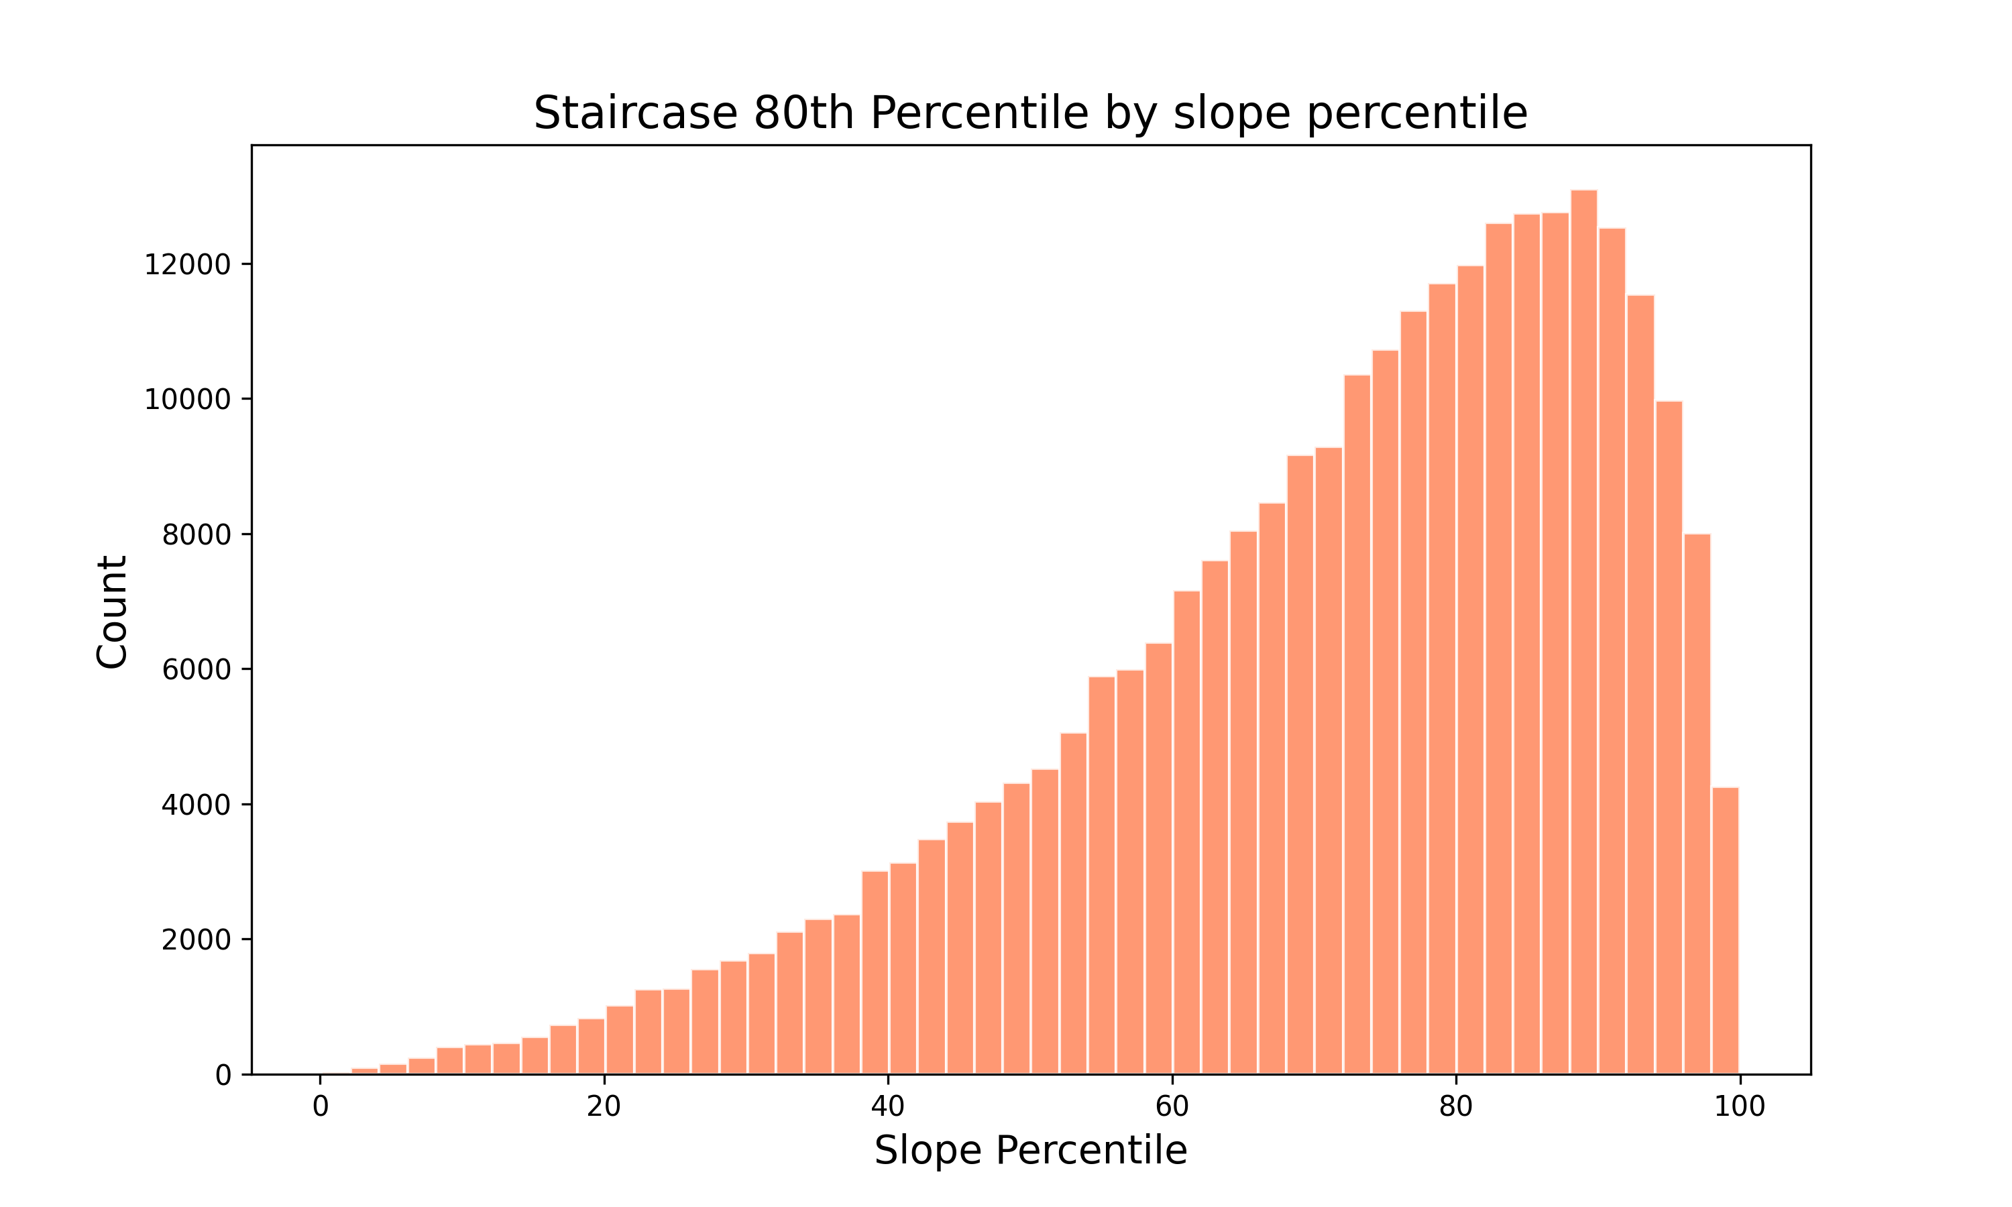
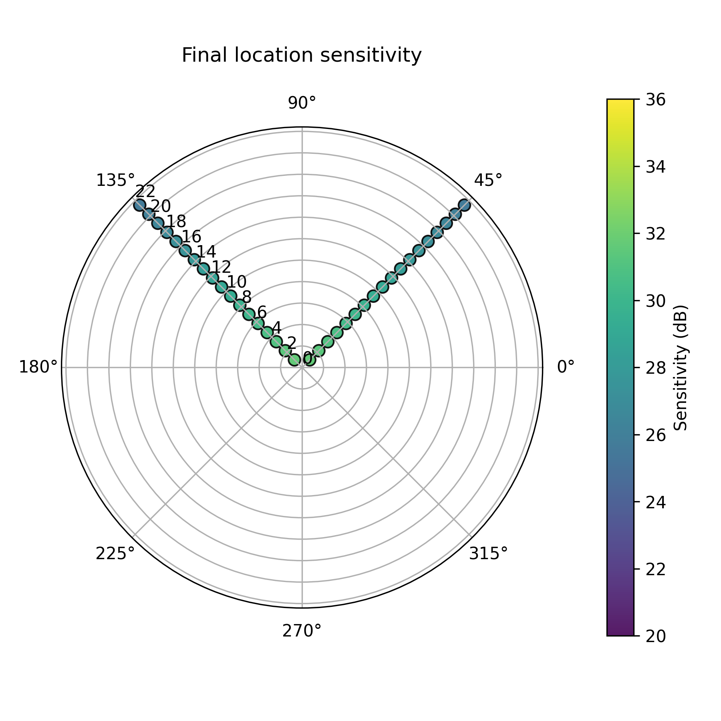
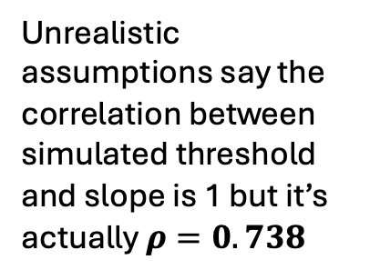
What are the results?
Unrealistic assumptions say the correlation between simulated threshold and slope is 1 but it’s actually $ρ=0.738$

Slide 14
Implications
Proves the final threshold value at each location is NOT solely dependent on sensitivity (simplified assumptions are wrong)
Confidence intervals on patient retinal sensitivities are too narrow
The fix is known: including false alarm and lapse rates in the observer model is computationally cheap and brings the assumed variability in line with reality

Slide 15
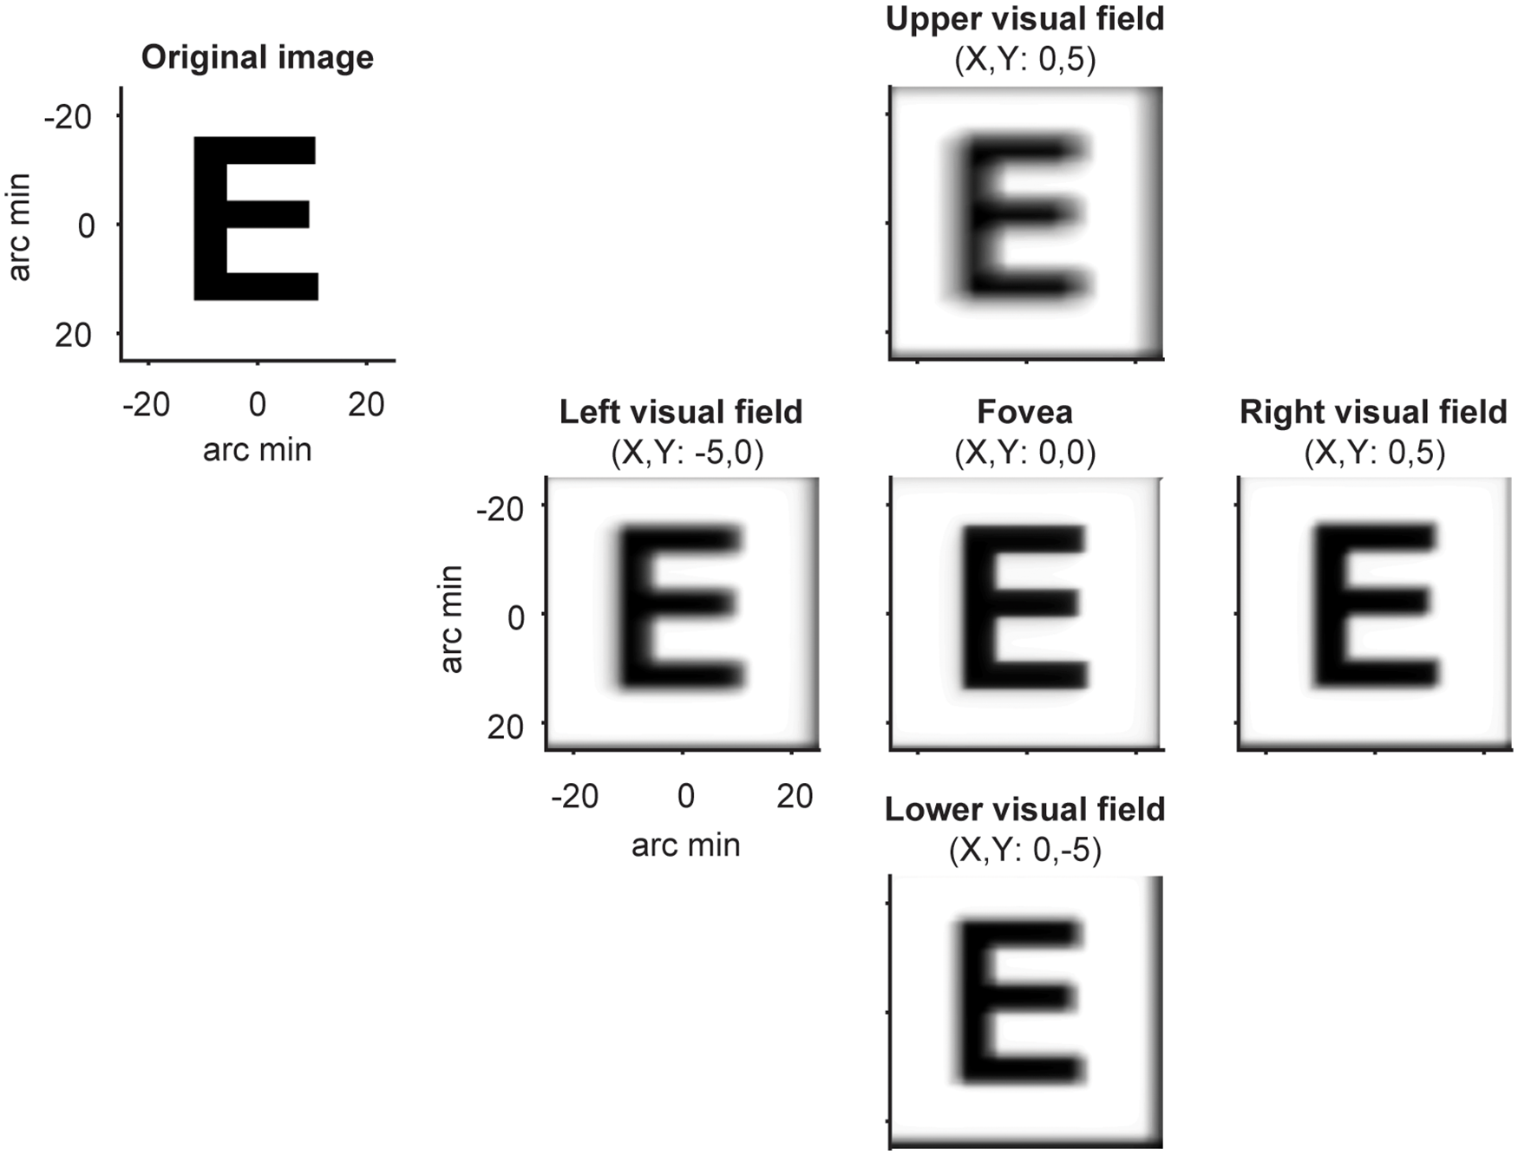
Future work
Modelling the an accurate ‘hill-of-vision’

Slide 16
Thank you!

